Slide 1
DSC 640 – Week 5 & 6 Executive summary, Dashboards and statistics Michael Ersevim

Slide 2
Airline Safety – Executive Summary Michael Ersevim (DSC640 – Wks 5&6) As you know, there is an initiative and marketing plan under development in order to combat the current negative media coverage of airline safety. Our company plans on releasing small, digestible statistics with accompanying graphs to demonstrate the relative safety of traveling by airplane. The messages regarding airline safety will be kept simple and direct in order to build a story with a lasting impression.

Slide 3
Unfortunately, it is difficult to encapsulate in just one or two descriptive statistics and graphs the relative safety of airline travel without comparing its safety record to other, more common and ‘mundane’ methods of travel - methods which few people give a second thought. The general public will only latch on to simple and clear statistics. However, the proper context for safety records necessarily comes with some math. They will need to also understand the exposure - that is, the number of miles traveled - to really appreciate how safe air travel is. Likening the chance of a fatality to another extremely unlikely event (i.e., lightning) may also be another effective way to reach the public in order to convince them that air travel is the safest way to go.

Slide 4
The media through which we reach the public would be radio spots, online advertisements when using travel app (like Orbitz or Travelocity) and billboards near airports with the stats in large print. Some of the ethical considerations are: to properly caveat statistics, to not cherry-pick years or statistics that are overly-favorable (by chance), and to use metrics that are as close to ‘apples-to-apples’ comarisons while still being relatable and understandable to the public.

Slide 5
Graphs and statistics to clearly show the narrative (U.S. Only): Graphs How many passenger miles are driven and flown in a year, by year How many deaths have occurred per 100,000 departures, by year How many fatalities per 100M miles driven. How many fatalities per 100M miles flown, all U.S. carriers combined. Statistics: Death rates compared to driving per 100M miles traveled. Odds of death from due to being struck by lightning.

Slide 6
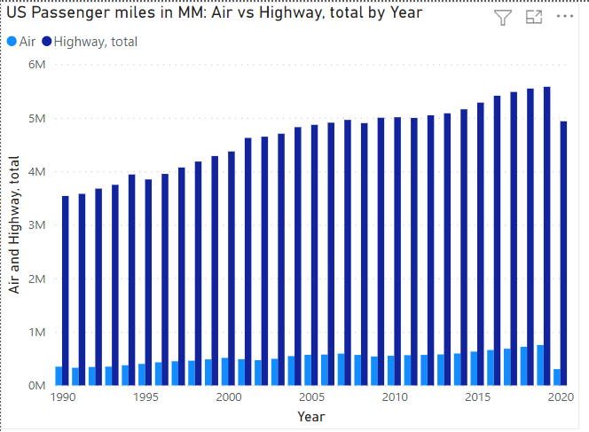

Slide 7
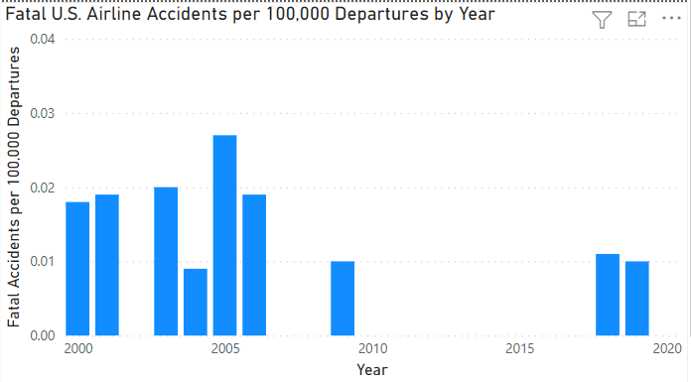

Slide 8
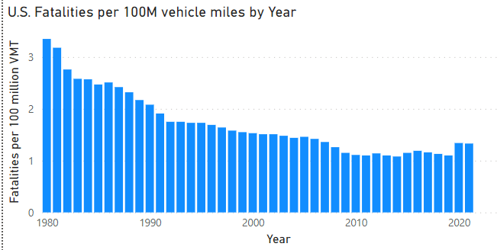

Slide 9
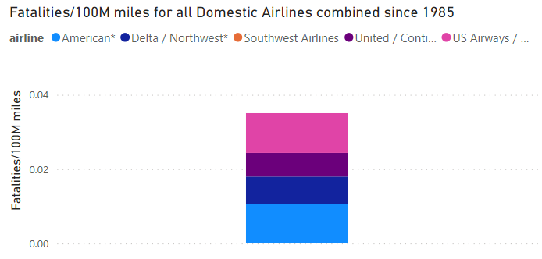

Slide 10
Statistics to emphasize the narrative (U.S. Only): Ratio of Highway miles to Airline miles: 7 to 1 Times safer flying is than driving per mile: 140 to 1 Times safer flying is than driving overall: 20 to 1 Average airline fatalities per year for the years 2000-2014: 23* How many people die every year in the U.S. from lightning: 41 * (excludes deaths from 9/11 terrorism, which wasn’t an accident)

